Slide 1
Chapter 7: Normalization

Slide 2
Lossless Decomposition
We can use functional dependencies to show when certain decomposition are lossless.
For the case of R = (R₁, R₂), we require that for all possible relations r on schema R
r = ∏_{R1} (r ) ∏_{R2} (r )
A decomposition of R into R₁ and R₂ is lossless decomposition if at least one of the following dependencies is in F⁺:
R₁ ∩ R₂ → R₁
R₁ ∩ R₂ → R₂
In other words, R₁ ∩ R₂ forms a superkey of either R₁ or R₂
The above functional dependencies are a sufficient condition for lossless join decomposition; the dependencies are a necessary condition only if all constraints are functional dependencies (there may be multivalued dependencies too – later)

Slide 3
Example
R = (A, B, C) F = {A → B, B → C)
R₁ = (A, B), R₂ = (B, C)
Lossless decomposition:
R₁ ∩ R₂ = {B} and B → BC
R₁ = (A, B), R₂ = (A, C)
Lossless decomposition:
R₁ ∩ R₂ = {A} and A → AB
Note:
B → BC
is a shorthand notation for
B → {B, C}

Slide 4
Dependency Preservation
Testing functional dependency constraints each time the database is updated can be costly
It is useful to design the database in a way that constraints can be tested efficiently
When decomposing a relation it is possible that it is no longer possible to do the testing without having to perform a Cartesian Product – See next slide
A decomposition that makes it infeasible to enforce one or more functional dependencies in original F, is said to be NOT dependency preserving.

Slide 5
Dependency Preservation Counter-Example
Consider a schema:
dept_advisor(s_ID, i_ID, dept_name)
With function dependencies:
i_ID → dept_name
s_ID, dept_name → i_ID
In the above design we are forced to repeat the department name once for each time an instructor participates in a dept_advisor relationship.
To fix this, we need to decompose dept_advisor
Any decomposition will not include all the attributes in
s_ID, dept_name → i_ID
Thus, the decomposition can NOT be dependency preserving

Slide 6
Dependency Preservation
Let F_{i} be the set of dependencies in F ⁺ that includes only attributes in R_{i}.
A decomposition is dependency preserving, if
(F₁ ∪ F₂ ∪ … ∪ F_{n} )⁺ = F ⁺
(Note that the definition of restriction uses all dependencies in in F ⁺, not just those in F)
Using the above definition, testing for dependency preservation take exponential time.
Note that if a decomposition is NOT dependency preserving then checking updates for violation of functional dependencies may require computing joins, which is expensive.

Slide 7
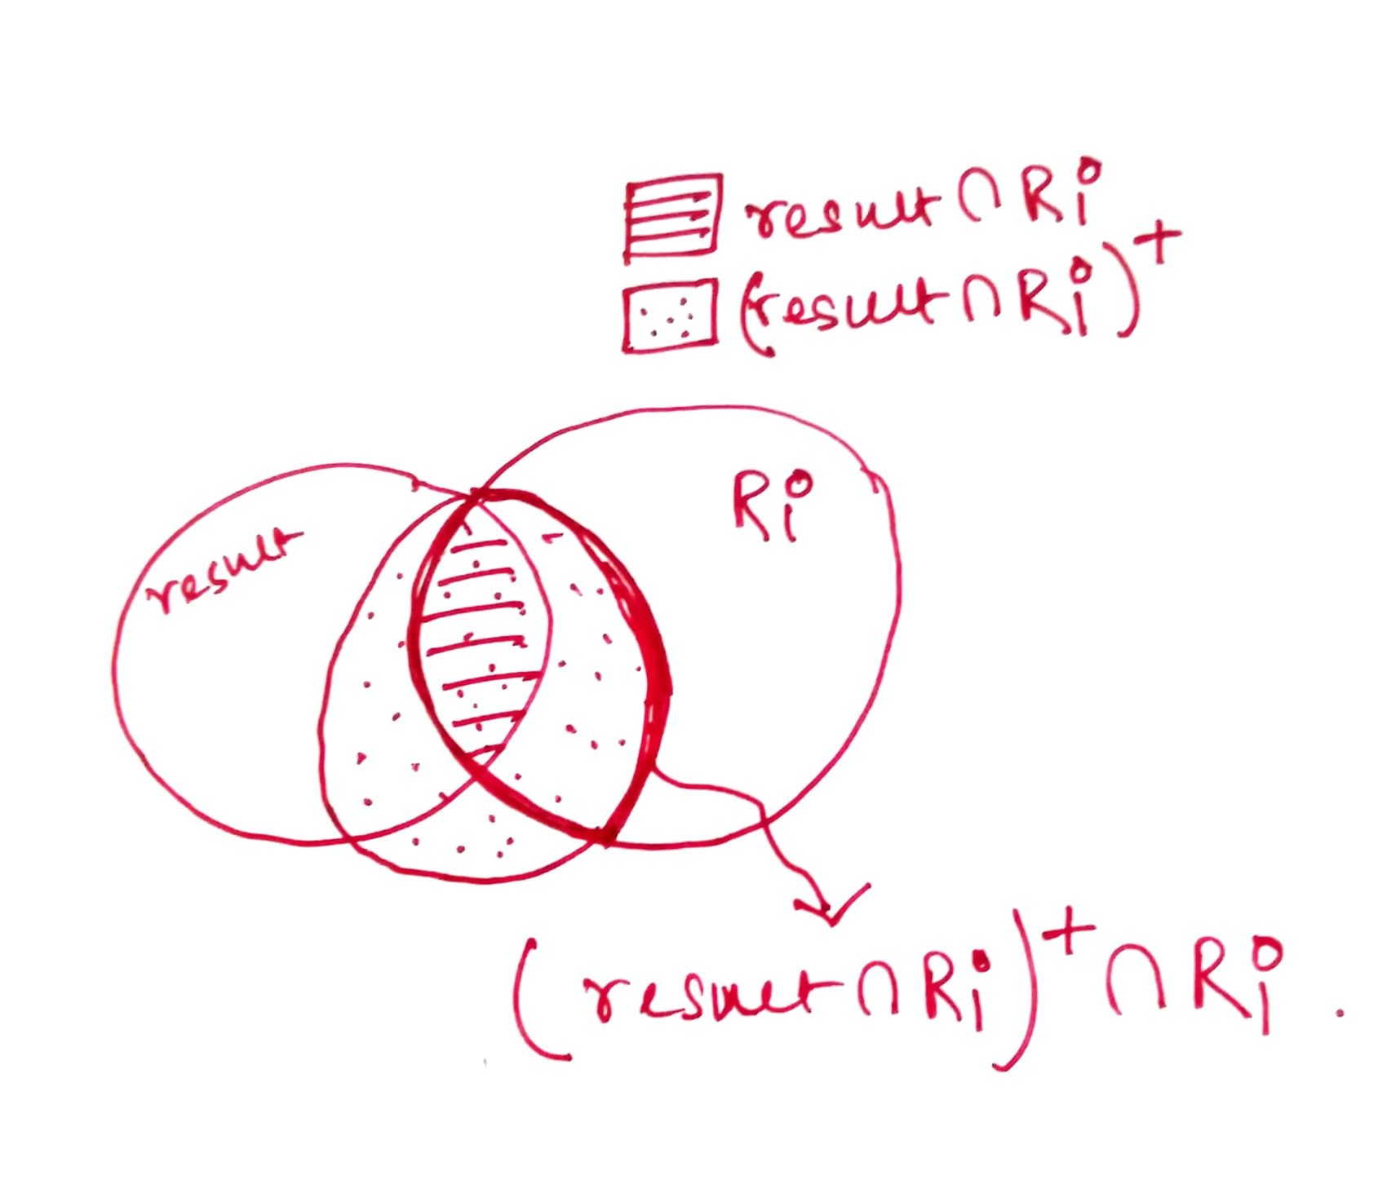
Testing for Dependency Preservation
To check if a dependency α → β is preserved in a decomposition of R into R₁, R₂, …, R_{n} , we apply the following test (with attribute closure done with respect to F)
result = α repeat for each R_{i} in the decomposition t = (result ∩ R_{i})⁺ ∩ R_{i} result = result ∪ t
end for
If result contains all attributes in β, then the functional dependency α → β is preserved.
We apply the test on all dependencies in F to check if a decomposition is dependency preserving
This procedure takes polynomial time, instead of the exponential time required to compute F⁺ and (F₁ ∪ F₂ ∪ … ∪ F_{n})⁺

Slide 8
Example
R = (A, B, C ) F = {A → B B → C} Key = {A}
R is not in BCNF
Decomposition R₁ = (A, B), R₂ = (B, C)
R₁ and R₂ in BCNF
Lossless-join decomposition
Dependency preserving

Slide 9
An Example of Dependency Preserving, but Lossy Decomposition
R (A,B,C) ➔ decomposed into R1 (A,B) and R2 (B,C)
➔
After applying natural join on R1 and R2 above, we get
A | B | C
1 | x | p
2 | x | q
3 | y | r
A | B
1 | x
2 | x
3 | y
B | C
x | p
x | q
y | r
A | B | C
1 | x | p
1 | x | q
2 | x | p
2 | x | q
3 | y | r

